Slide 1
NSS mahuva nss management system
Presented by shailesh

Slide 2
Table of contents
Introducing
Project introduction
configuration
System design
Input / output design
Testing and implementation
Conclusion
Feature and goal

Slide 3

1. introduction
The NSS Management System streamlines volunteer registration, event tracking, and activity reporting for National Service Scheme units. It enhances coordination, engagement, and impact assessment efficiently.

Slide 4
synopsis
PROJECT TITLE:
NSS MANAGEMENT SYSTEM
LANGUAGE:
REACT NATIVE – EXPO
NODEJS
MYSQL
DEVICE & TOOLS
EXPO GO - ANDROID APP
VS CODE

Slide 5
2. PROJECT INTODUCTION
The NSS Management System is an Android app designed to streamline the registration and management of events within the National Service Scheme. Users can sign in, sign up, and edit their profiles to stay up to date with upcoming and past events. The app also allows users to register for events, providing an easy way to engage with the program.
For administrators, the app offers comprehensive control over event management, user registrations, and user data. Admins can add, modify, or delete events, handle event registrations, manage user profiles, and organize an image gallery to showcase event photos. This system enhances coordination and engagement within the NSS community.

Slide 6
Objectives of system
User Authentication
Event Registration.
Event Management.
User Management
Registration Tracking.
Event Visibility.
Image Gallery Management
User Engagement
Admin Control Panel

Slide 7
3. configuration
Hardware Requirements
software Requirements
Processor: Intel Core i5 or higher (recommended)
RAM: 8GB (minimum), 16GB (recommended for smooth multitasking)
Storage: 256GB SSD (minimum), 512GB SSD (recommended)
Operating System: Windows 10/11, macOS, or Linux
Node.js (Latest LTS version) – Required for running React Native
MySQL Server – Database for storing user, event, and registration data
Expo Go (Mobile App) – For testing the app on real devices

Slide 8
tables
4. System design
users
events
registration
Images
Nss store

Slide 9
Users table structure
Field Name | Data Type and Size | Key
Id | Int | primary key , auto inrement
name | Varchar(50) | not null
email | Varchar(100) | unique not nul
password | Varchar(100) | not null
phone | Varchar(20) | -
role | Enum(‘1’,’a’) | Default(‘1’)
Img | Made in the first 15 seconds | -

Slide 10
Events table structure
Field Name | Data Type and Size | Key
Id | Int | primary key , auto increment
name | Varchar(50) | not null
description | text | null
location | Varchar(100) | null
start time | datetime | not null
End time | datetime | not null
Num Of User | int | 0
image | Varchar(255) | null
Create by | int | Users(id)

Slide 11
images table structure
Field Name | Data Type and Size | Key
Id | Int | primary key , auto inrement
imageUrl | Varchar(255) | not null
E id | - | Events(id)

Slide 12
Nss store table structure
Field Name | Data Type and Size | Key
Id | Int | primary key , auto inrement
Items name | Varchar(255) | not null
Num of item | int | Not null

Slide 13
registration table structure
Field Name | Data Type and Size | Key
Id | Int | primary key , auto inrement
User id | int | Users(id)
Event is | int | Users(id)
Registration date | Timestamp | Current time stap
status | ENUM(‘panding’,’conform’,’cancel’) | -

Slide 14
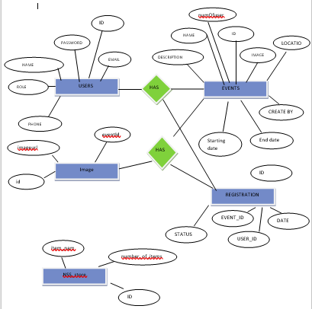
ER Diagram

Slide 15
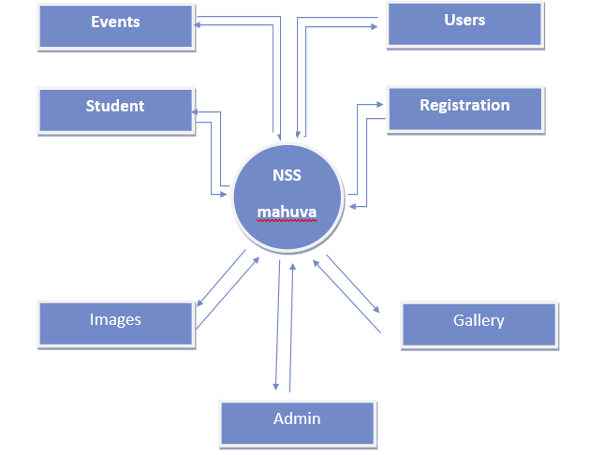
0 level Admin

Slide 16
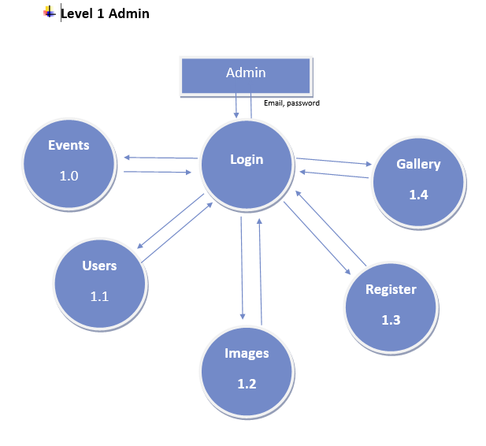
1 level dfd admin

Slide 17
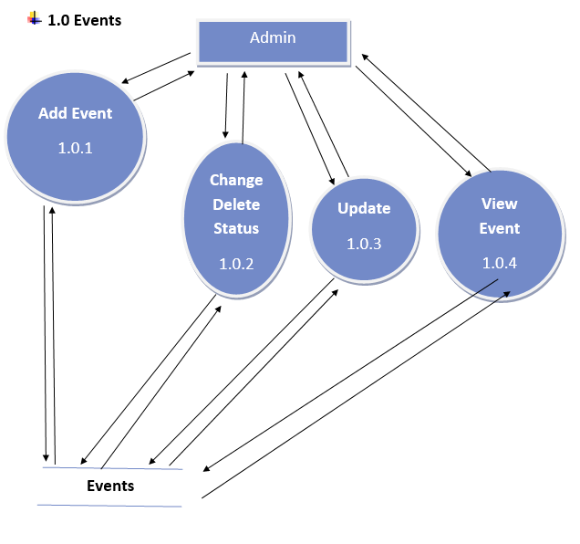
2 level admin – 1.0

Slide 18
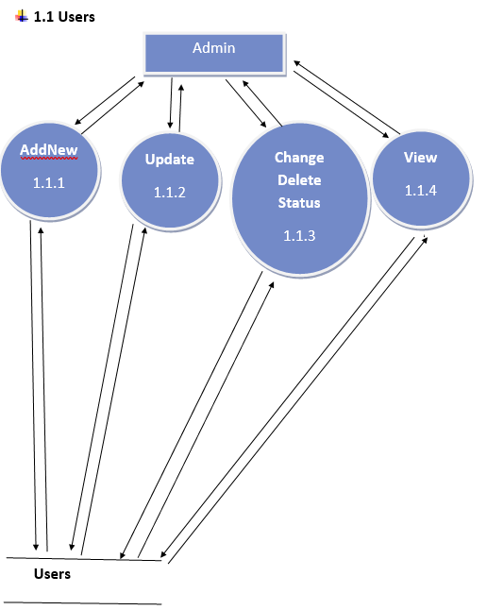
2 level admin – 1.1

Slide 19
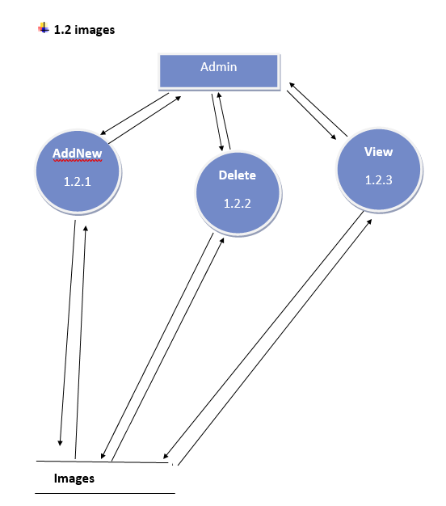
2 level admin – 1.2

Slide 20
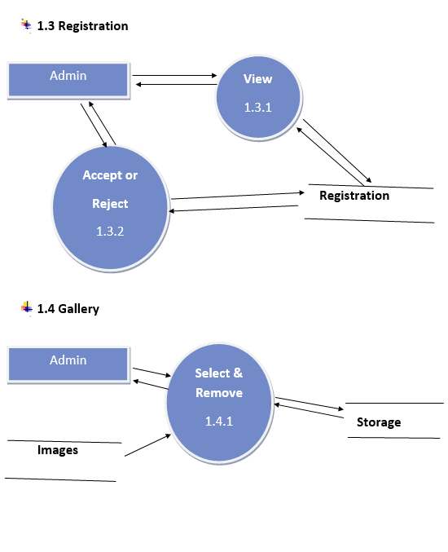
2 level admin – 1.3

Slide 21
2 level admin 1.3,4

Slide 22
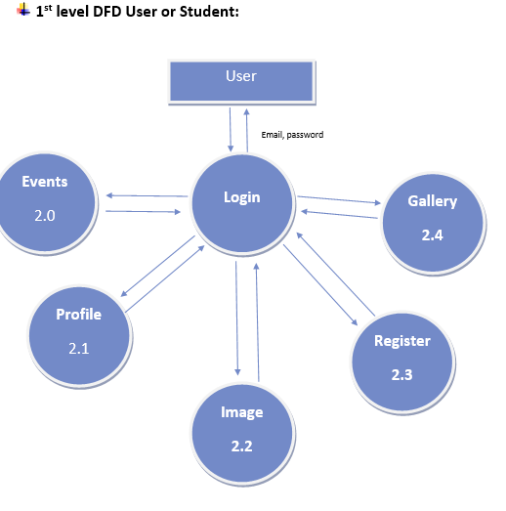
1 level user

Slide 23
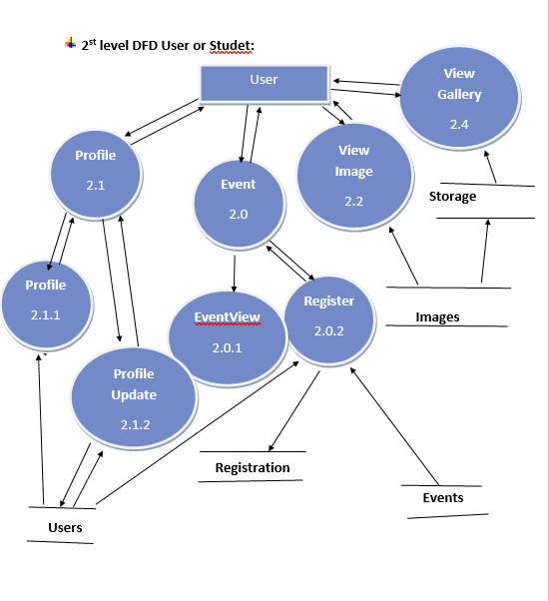
2 level user dfd

Slide 24
conclusion
The NSS Management System app, built using React Native with Expo for the frontend and Node.js with MySQL for the backend, provides a seamless and efficient platform for managing NSS activities. This system enhances user engagement by enabling easy event registration, profile management, and event tracking. For administrators, it offers robust tools to manage events, registrations, users, and an image gallery, ensuring smooth coordination within the NSS community.
With a user-friendly interface and a structured database, this app improves accessibility and efficiency for both users and admins. By leveraging modern technologies, it simplifies the management process, fosters greater participation in NSS activities, and ensures an organized digital experience.

